Slide 1
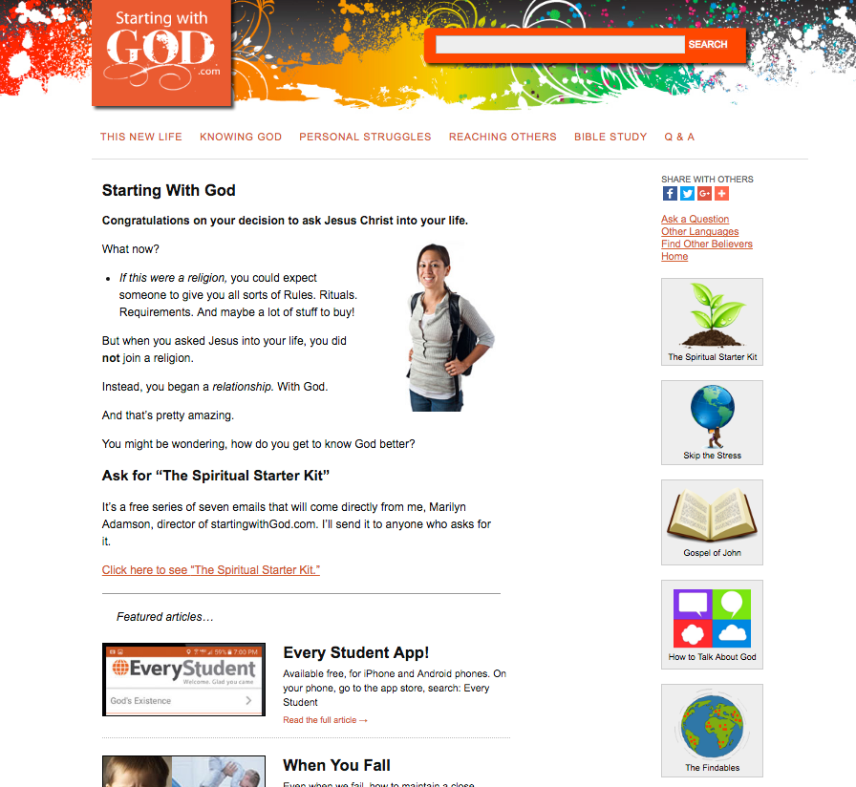

Slide 2
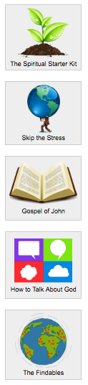

Slide 3
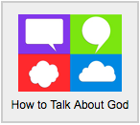
“I am smiling as I read this. It’s awesome. Now I have some idea on how I should interact with unbelievers. The website is really helpful.”

